Slide 1

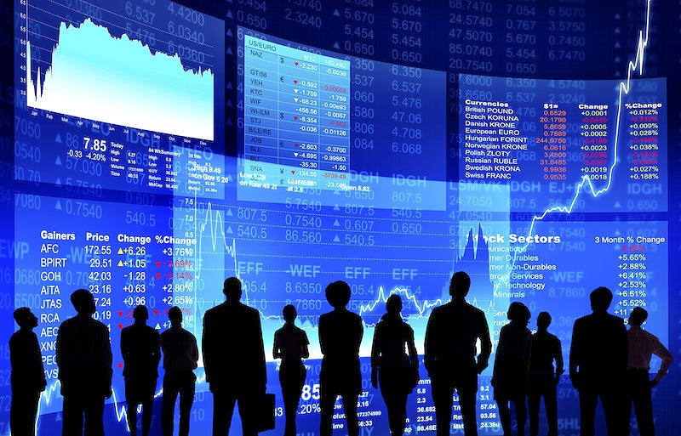
Stock Market Analysis
Group Members
Mr. Himanshu Patil
Mr. Mayank Sharma
Mr. Rahul Andhale
Mr. Pranshu Bhatnagar
Ms. Pooja Udaykumar
Mr. Nachan Samnan Sahir

Slide 2
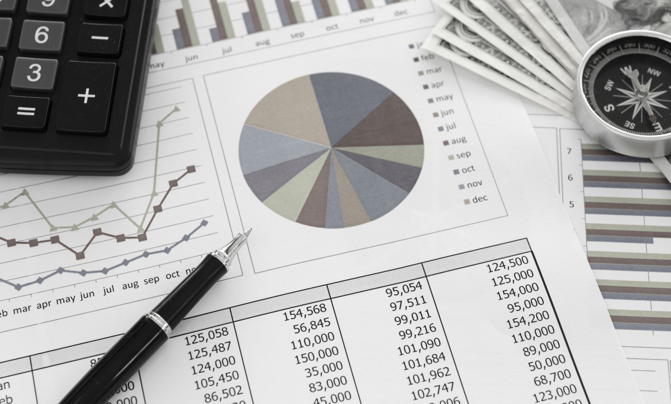
Business Objective
The primary objective of this project is to provide insights into the stock market performance of the selected major companies. Through analysis, we aim to identify patterns, trends, and anomalies in the stock’s behaviour over time. By doing so, we hope to make informed decisions regarding the stock purchases, sales, or holdings, potentially.

Slide 3
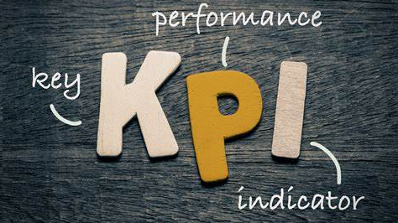

Slide 4
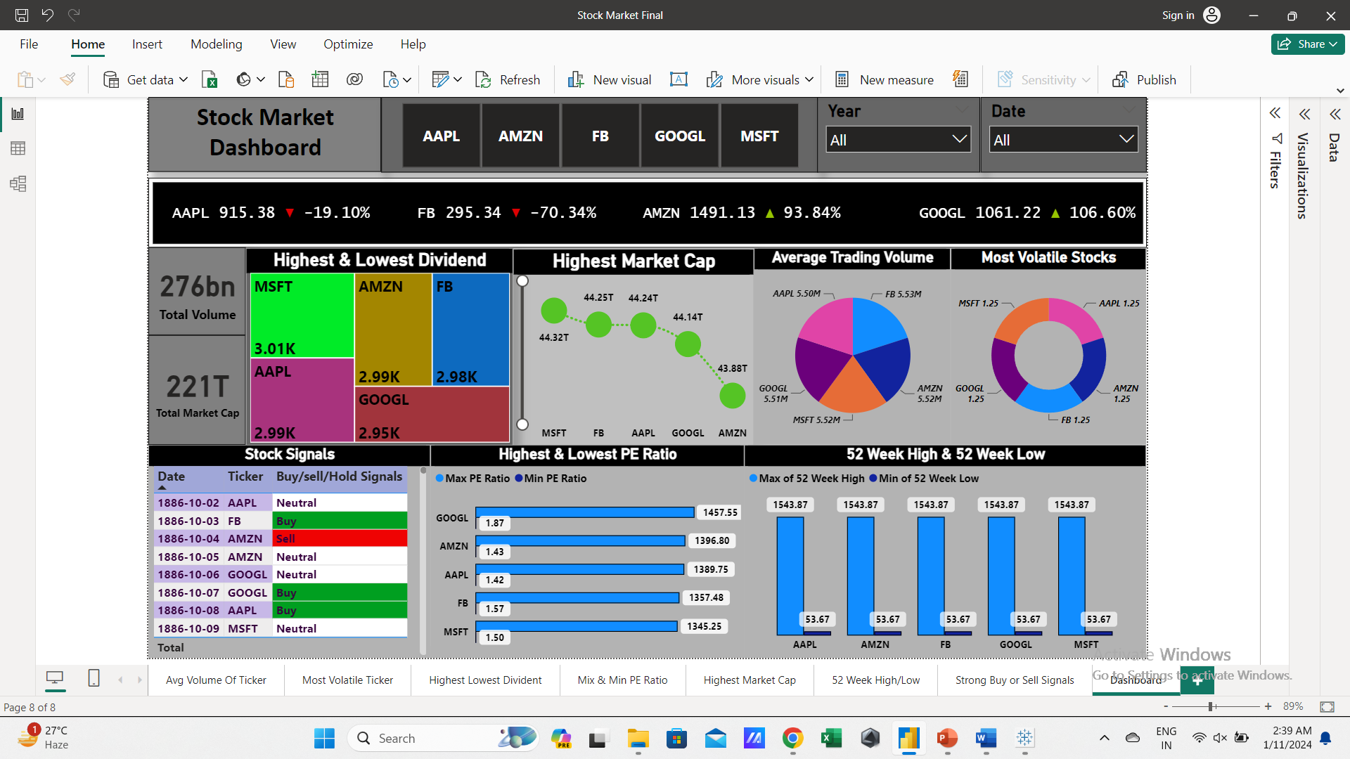
Objective :-
Find average number of shares traded daily.
When trading volume is up—whether it’s buying or selling volume—it means the security is gaining attention and trading activity is increasing.
Average Daily Trading Volume
Findings:-
FB has Highest Average Daily Trading Volume 5.53M.
AAPL has Lowest Average Daily Trading Volume 5.50M.
There is not much difference between Highest Average Daily Trading Volume and Lowest Average Daily Trading Volume.

Slide 5
Objective :-
Identify stocks with the highest Beta values. Stocks with the highest beta values typically indicate that they are more volatile and have higher price sensitivity to market movements compared to overall market Index.
Most Volatile Stock
Findings:-
Stocks with beta value higher than 1.0 can be interpreted as more volatile.
All Companies have almost same Average Beta Values.
There is no major difference in average beta values, we need to look at more parameters to come a conclusion which stock to buy.

Slide 6
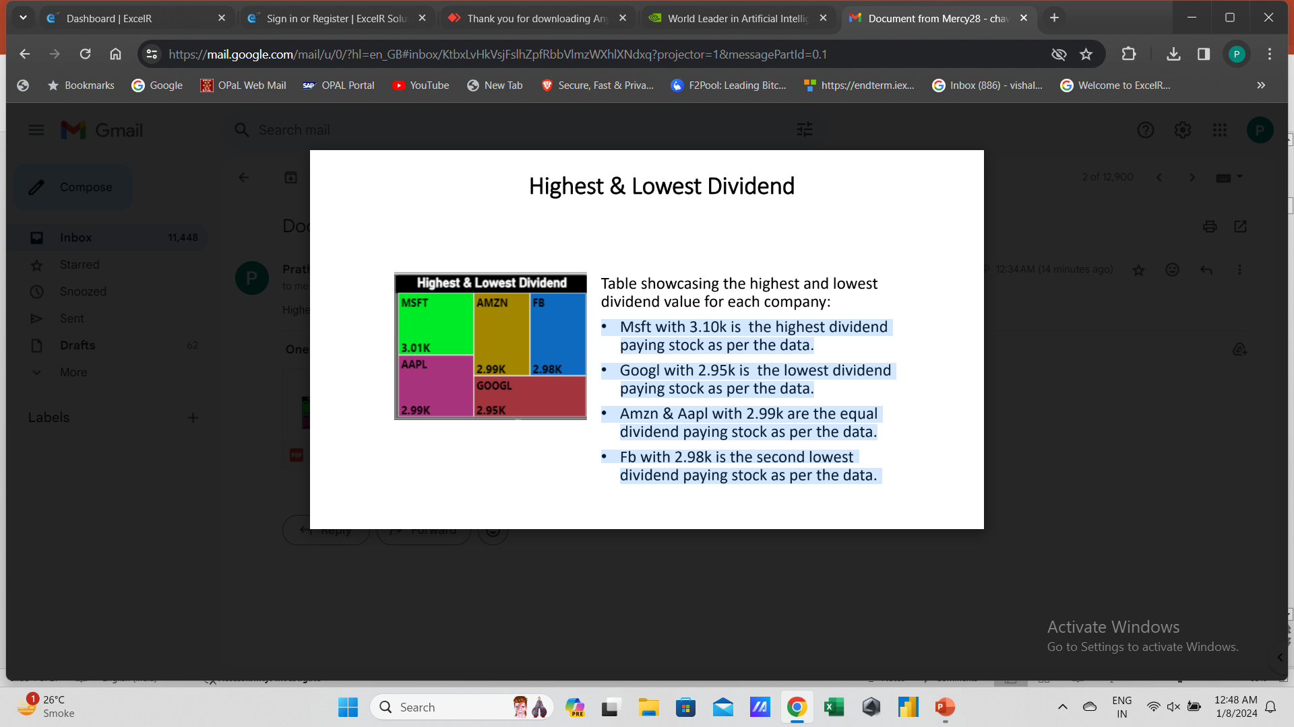
Objective :-
Identify Stocks that have provided the highest dividend amounts and lowest amounts. Stocks with low or no dividends are often associated with growth investing.
Highest
&
Lowest Dividend
Findings:-
A dividend is a reward paid to the shareholders for their investment in a company’s equity and it usually originates from the company's net profits.
Msft with 3.01k is the highest dividend paying stock as per the data.
Googl with 2.95k is the lowest dividend paying stock as per the data.
Amzn & Aapl with 2.99k are the equal dividend paying stock as per the data.
Fb with 2.98k is the second lowest dividend paying stock as per the data.

Slide 7
Objective :-
Identification of stocks with the highest and lowest Price-to-Earnings ratios. High P/E ratios are often associated with stocks growth in the future. Low P/E ratios are often associated with value stocks. These stocks are perceived as undervalued by the market.
Highest
&
Lowest
P/E Ratios
Findings:-
AAPL: Highest - 1.39K, Lowest - 1.42K
AMZN: Highest - 1.40K, Lowest - 1.43K
FB: Highest - 1.36K, Lowest - 1.57K
Google: Highest - 1.46K, Lowest - 1.87K
MSFT: Highest - 1.35K, Lowest - 1.50K
Google exhibits the highest P/E ratio at 1.46K, while AAPL shows the lowest at 1.42K. These variations in P/E ratios indicate diverse investor sentiments and potential risks. Higher P/E ratios, such as Google's 1.46K, may suggest optimistic growth expectations, while lower ratios, as seen in AAPL at 1.42K, might indicate potential undervaluation or concerns about future performance.

Slide 8
Objective :-
Identify stock with the largest market capitalizations. Stocks with the highest market cap offer stability and liquidity
Stocks
With Highest
Market
Cap
Findings:-
Market Cap is a measure of a company’s total market value.
Using line chart we have shown the market cap of all the 5 stocks.
"Market Cap Year on Year" A positive percentage indicates an increase, while a negative percentage indicates a decrease. AMNZ has a positive increase YoY% of approx 6.33%
MSFT has the highest market cap among the other stocks with 44.32T followed by FB with 44.25T.
AMNZ has the lowest market cap of 43.88T in comparison to other given stocks.
High Market Cap signifies that the company has a larger presence in the market.
Larger companies may have less growth potential compared to start –up firms.
Larger companies with higher market caps usually have more actively traded stocks. This means there is greater liquidity, making it easier for investors to buy or sell shares without significantly impacting the stock price.

Slide 9
Objective :-
Find stock’s 52 week high (The highest price at which a particular stock has traded over the past 52 weeks (one year) and 52 week low high (The lowest price at which a particular stock has traded over the past 52 weeks (one year)
Stocks Near 52 Week High &
52 Week Low
Findings:-
The 52 weeks high for all the stocks in 1,544..
From the dashboard we can find that AMZN is closest to the 52 weeks high with current rate of 1491.13.
We can also observe that FB is farthest from 52 weeks high with current rate of 295.34.
52 weeks low for all the stocks is 53.67.
We can observe from the dashboard that FB is the closest to 52 weeks low with current rate of 295.34.
We can also observe that AMZN is farthest from 52 weeks low with current rate of 1491.13.

Slide 10
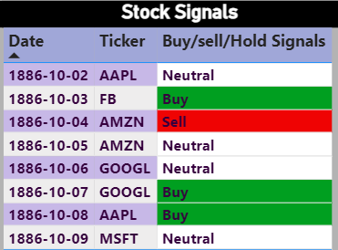
Objective :-
Using the MACD and RSI values, find the stocks that are potentially good buys on a given day.
Stocks
With Strong
Buy Signals & Stocks
With Strong
Selling Signals
Findings:-
RSI below 45 indicates oversold market and a sign of potential buying. Whenever RSI value is between 45 and 68 is often considered as a neutral zone. Whenever RSI value is greater than or equal to 69 indicates overbought condition and a sign of potentially strong selling opportunity.
When the MACD value is greater than 0, it is buying signal and when the MACD value is less than 0 it is a selling signal.
As on 1886-10-02 we have NEUTRAL (HOLD) Signal for AAPL stock.
As on 1886-10-03 we have BUY Signal for FB stock.
As on 1886-10-04 we have SELL Signal for AMZN stock.

Slide 11

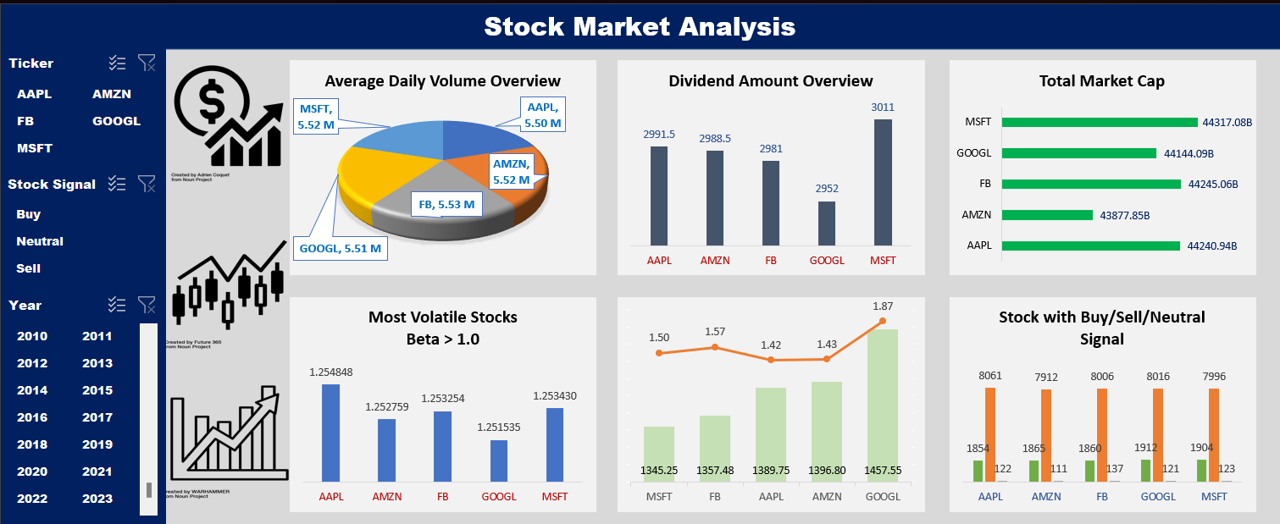
Microsoft Excel

Slide 12
Power BI

Slide 13
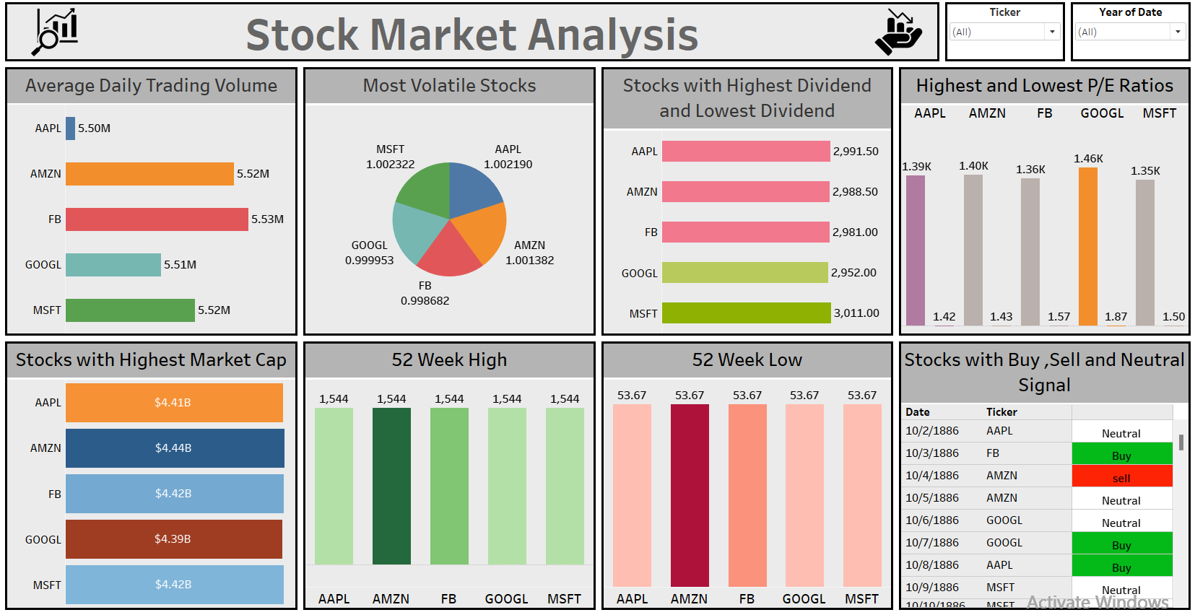
Tableau

Slide 14
Challenges
Initial challenge was understanding the data. Because of less understanding of stock market it took time to understand each feature and it’s importance.
Second is handling large data specially at the time of importing data in sql as it took bit more time.
Third is finding difference between values of kpi, because there is almost negligible difference between summarized values.
Fourth is choosing the right chart for each kpi.

Slide 15

Thank You for Your Time and Attention

